Slide 1
Today
Lecture 19: The rf and dc SQUID --- models
Discussion of SQUIDs in two parts:
Models
Operation and applications
Next time
Lecture 20: The dc SQUID --- operation and applications

Slide 2

dc SQUID
Superconducting QUantum Interference Device
Mercereau 1964
Zimmerman 1969
2 Josephson junctions
dc bias
based on quantum interference
single JJ
rf bias
based on non linearity

Slide 3





rf SQUID (Superconducting Quantum interference Device) --- not a SQUID (no interference)
X
$$L$$
$$I$$
$$Φ$$
$$Φ_{x}$$
Phase coherence:
non-hysteretic
hysteretic
Single-junction inductance parameter
slope at half-integer $Φ_{0}$

Slide 4
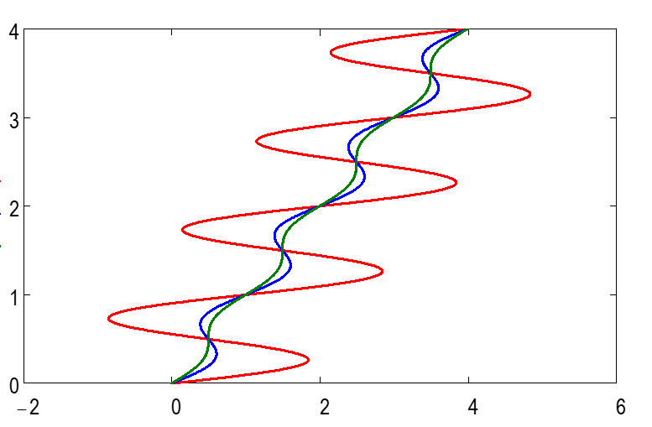
Hysteretic switching for

Slide 5





rf SQUID dynamics
$$Φ_{x}$$
(1)
RSJ model
(2)
Josephson relation
(3)
Phase coherence
$$I$$
Flux contributions
(4)
Looks like an RSJ model with a different potential

Slide 6
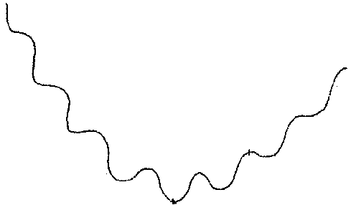
Potential:
magnetic energy
Josephson coupling energy
X
Parabolic potential + corrugation
Josephson coupling energy
Circulating current
0
1
2

Slide 8
Direct measurement of the Current-Phase Relation
Screening technique (Jackel)
Interferometer technique (Waldram)
I_{c}
I_{c}
Junction embedded in SC loop (rf-SQUID)
Inject flux  induces circulating current
Detect flux with SQUID
Junction in SC loop (rf-SQUID)
Inject current  divides according to phase
Detect flux with SQUID
Extract CPR

Slide 9
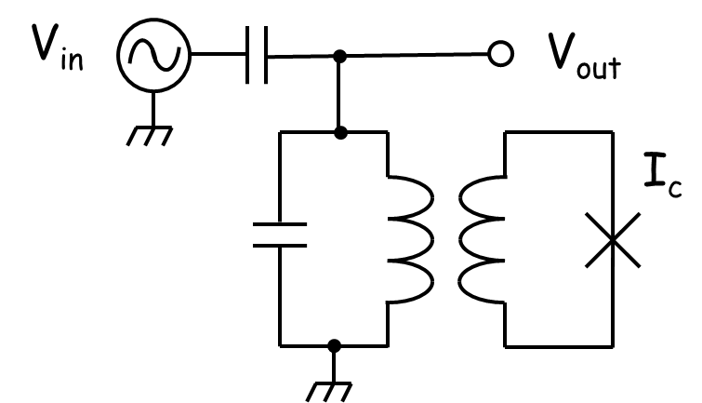
Direct measurement of the Current-Phase Relation
Dispersive technique (Silver, Deaver, Il’ichev)
Asymmetric dc SQUID technique
I_{c1}
I_{c2}
I_{c1} << I_{c2}
Junction embedded in SC loop (rf-SQUID)
inductively-coupled to a tank circuit
Excite with rf signal  induces rf currents
Readout phase shift between V_{in} and V_{out}
Extract CPR
Junction embedded in dc SQUID
Apply flux  induces circulating current
Measure critical current vs. flux
Modulation is dominated by the phase evolution of the small junction

Slide 10

dc SQUID
Superconducting QUantum Interference Device
Mercereau 1964
n-junction interferometers
2 Josephson junctions
dc bias
based on quantum interference
Can think of a dc SQUID as single junction with an inhomogeneous critical current density

Slide 11


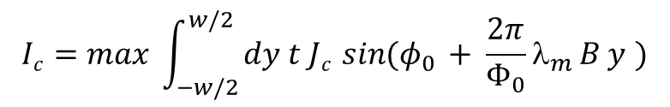
Josephson Interferometry: response to a magnetic field
x
magnetic thickness of barrier
barrier
thickness
φ₀
φ(y)
λ_{m} = b +2λ
λ_{m}
b
y
 B
Phase coherence  magnetic field induces a phase variation:
Uniform magnetic field ⇒
and small junction limit
 linear phase variation
Uniform junction ⇒
 Fourier transform
Fraunhofer diffraction pattern
Single-slit optical interference

Slide 12

Josephson Interferometry: what it can tell you
Critical current variation
Magnetic field variations
Gap anisotropy
Domains
Charge traps
Current-phase relation
Order parameter symmetry
Flux focusing
Self-field from tunneling current
Trapped vortices
Magnetic particles
Non-sinusoidal terms
π-junctions
Exotic excitations e.g. Majorana fermions
Unconventional superconductivity

Slide 13
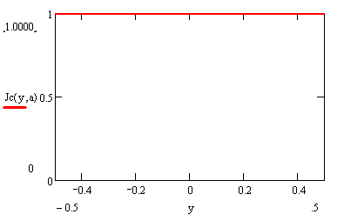
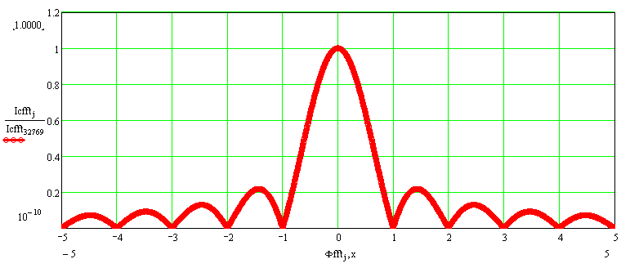
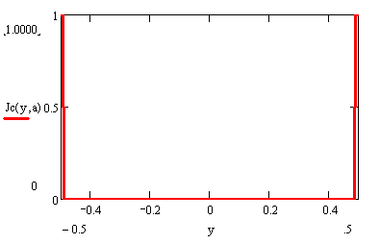
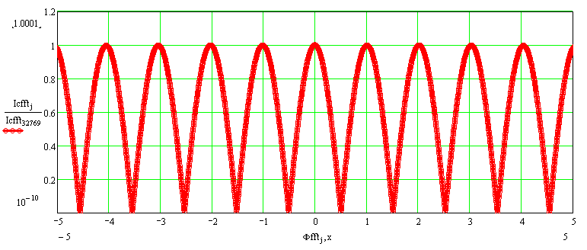
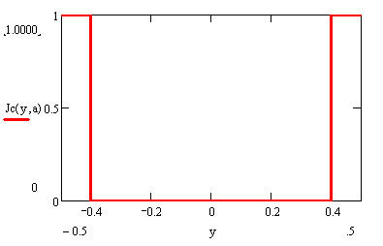
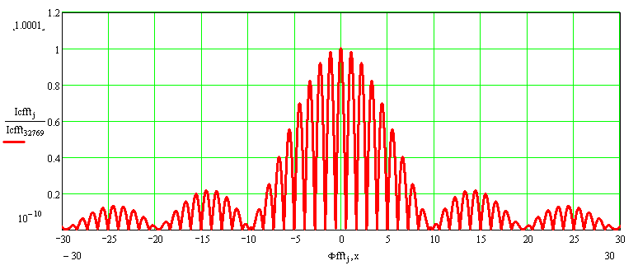
Josephson Interferometry: critical current variations
Uniform junction
Narrow junction dc SQUID
Wide junction dc SQUID

Slide 14
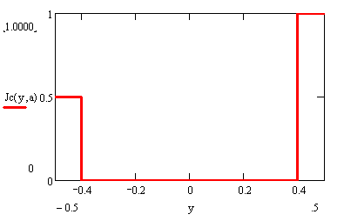
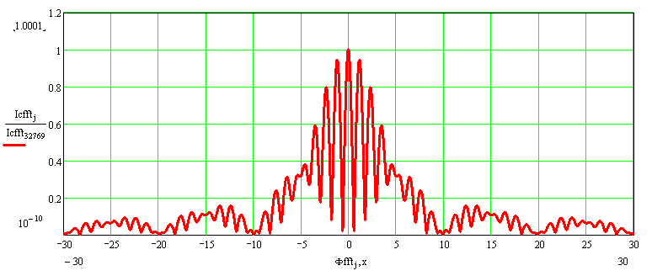
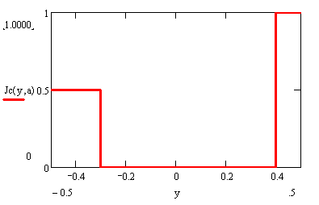
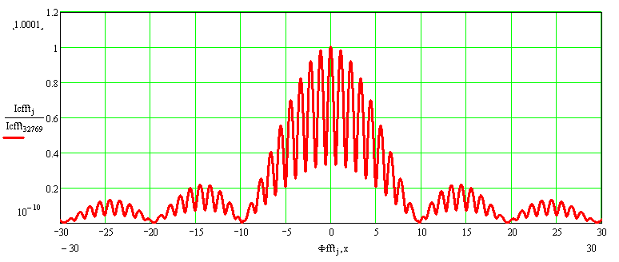
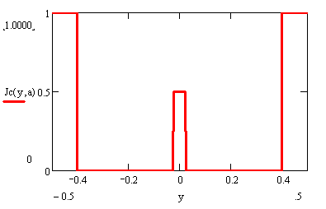
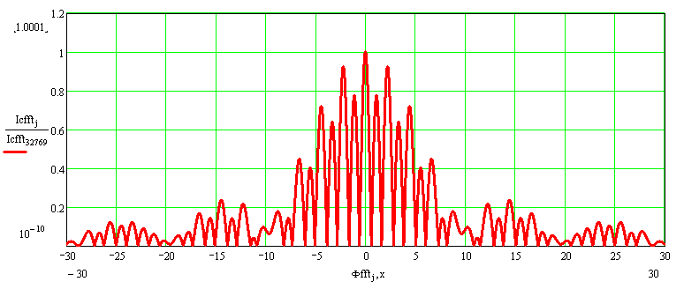
Josephson Interferometry: more critical current variations
Asymmetric junctions (magnitude)
Asymmetric junctions (magnitude and width)
Three-junction SQUID

Slide 15

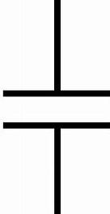
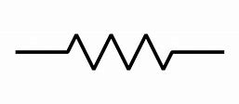







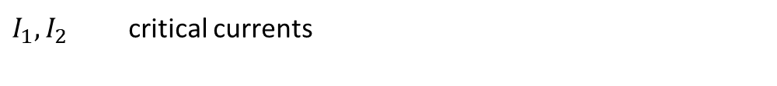
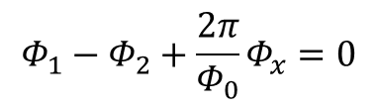


$$L$$
2 – JJ interferometer
$I_{1}{,I}_{2}$ critical currents
$$I_{1}$$
$$I_{2}$$
$I_{c}=$SQUID critical current
$$Φ_{x}$$
ignore inductance (ignore magnetic fields due to currents in SC – same as ignoring self-field effects)
$$I_{ }=I_{1}\sin{φ_{1}}+I_{2}\sin{φ_{2}}$$
Simplest case : $I_{1}=I_{2}=I_{0}$
$I_{ }$ ${=I}_{0}\left(\sin{φ_{1}}+\sin{φ_{2}}\right)$
$$Φ_{1}−Φ_{2}+\frac{2π}{Φ_{0}}Φ_{x}=0$$
Phase constraint:
If $Φ_{x}=0$, $φ_{1}=φ_{2}=\frac{π}{2}$
Both junctions can carry the maximum supercurrent
If $Φ_{x}≠0$, $φ_{1}≠φ_{2}$ so both $φ_{1}$ and $φ_{2}$ cannot assume their max values
$$⇒ I_{c}<2I_{o}$$

Slide 16
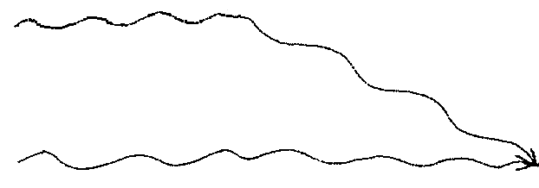
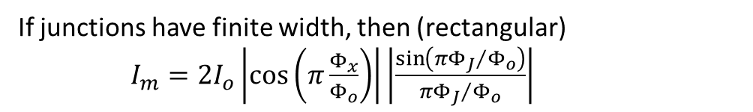
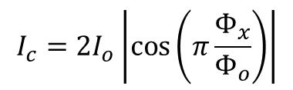



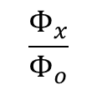
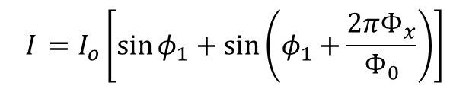

Solution
$$φ_{2}$$
$$I_{ }=I_{o}\left[\sin{φ_{1}}+\sin\left(φ_{1}+\frac{2πΦ_{x}}{Φ_{0}}\right)\right]$$
$$I_{c}$$
$=\left[2I_{o}\cos\left(π\frac{Φ_{x}}{Φ_{o}}\right)\right]\sin\left(φ_{1}+π\frac{Φ_{x}}{Φ_{o}}\right)$
$φ_{1}$ can adjust to allow maximum current (as before)
$$\frac{Φ_{x}}{Φ_{o}}$$
I I
I I
$$I_{c}=2I_{o}\left|\cos\left(π\frac{Φ_{x}}{Φ_{o}}\right)\right|$$
-2
-1
0
1
2
$ΔI_{c}=$ modulation depth $=2I_{o}$
Analogous to two-slit interference pattern
If junctions have finite width, then (rectangular)
$I_{m}=2I_{o}\left|\cos\left(π\frac{Φ_{x}}{Φ_{o}}\right)\right|\left|\frac{\sin\left(π{Φ_{J}}/{Φ_{o}}\right)}{π{Φ_{J}}/{Φ_{o}}}\right|$

Slide 17
dc SQUID
A dc SQUID consists of two junctions embedded in a superconducting loop
Φ
I_{c1}
I_{c2}
Symmetric SQUID → I_{c1} = I_{c2} = I₀
Asymmetric SQUID → I_{c1} > I_{c2}
I_{c1}+I_{c2}
Modulation reduced
Critical current (I₀)
Modulates to zero
Critical current (I₀)
I_{c1}-I_{c2}
(I_{c1}=1.5, I_{c2}=0.5)
Applied flux (Φ₀)
Applied flux (Φ₀)

Slide 18
dc SQUID w/ inductance
A finite inductance modifies the SQUID characteristic because the circulating currents generate a flux in the loop that adds to the applied flux
This is an example of “self-field effects” in which the fields from the Josephson currents cannot be ignored
Inductive SQUID
J = I₁-I₂ = circulating current
Φ = applied flux
Modulation reduced
Critical current (I₀)
β=1
Applied flux (Φ₀)
Dependence on β

Slide 19
Asymmetries modify the SQUID modulation
critical current asymmetry
inductance asymmetry

Slide 20
dc SQUID dynamics
Generalized RSJ (circuit model):
I
I₁
since
Phase constant:

Slide 21
Set of complex equations for:
Given
both junctions
control parameters
As in RSJ, can model phase evolution as a particle moving in a potential
2D washboard potential:
Symmetric case

Slide 22
2D washboard
tilt along diagonal
trough parallel diagonal, shifted by
Low β – trough narrow ⇒ motion along diagonal
High β – through shallow ⇒ motion side to side allowed
wells in
different depth – reduce
current puts flux in loop – shifts
vs.
damping different in different directions
inertia different in different directions

Slide 27
